Slide 1

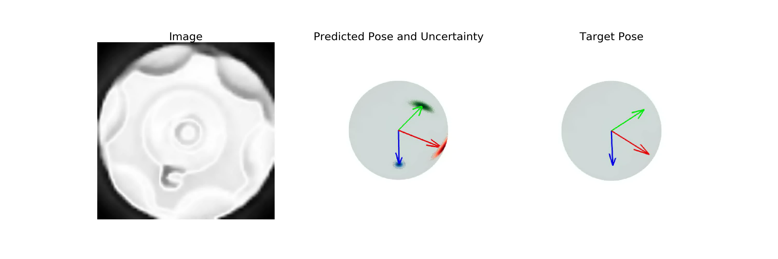
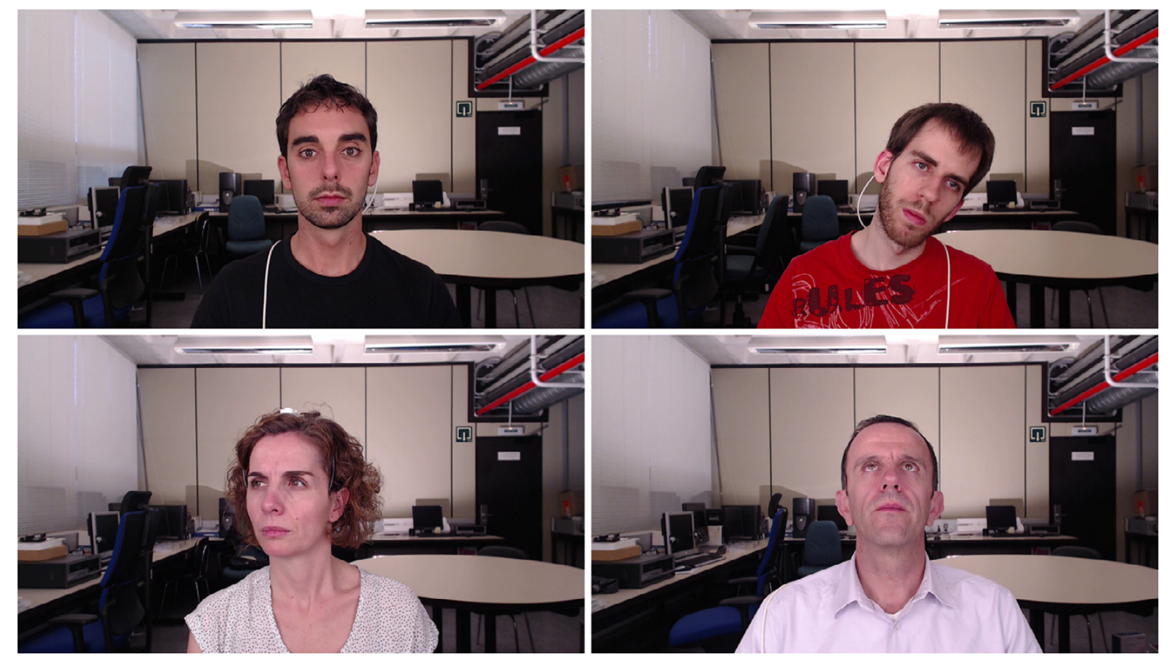
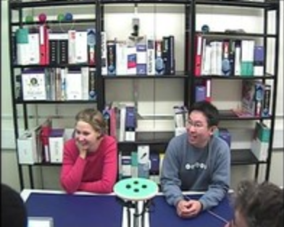
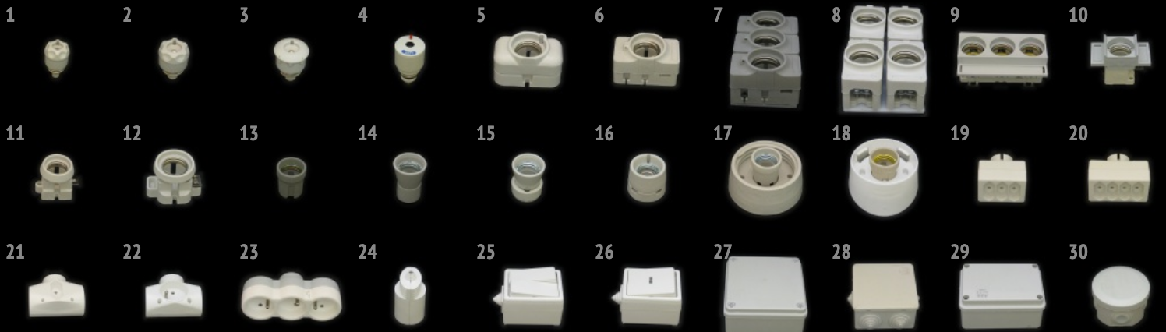
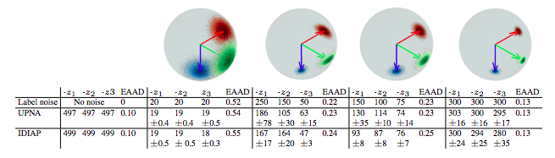
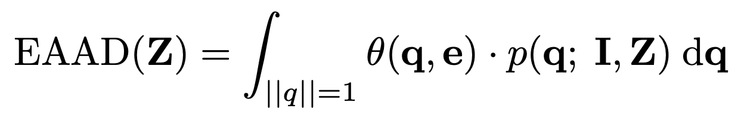
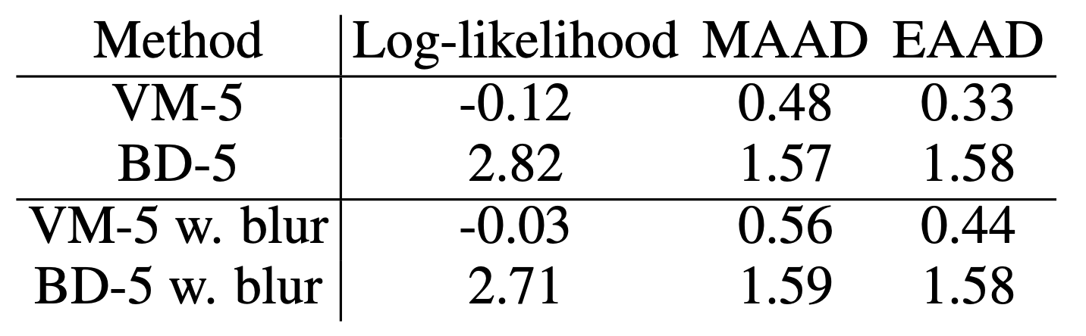
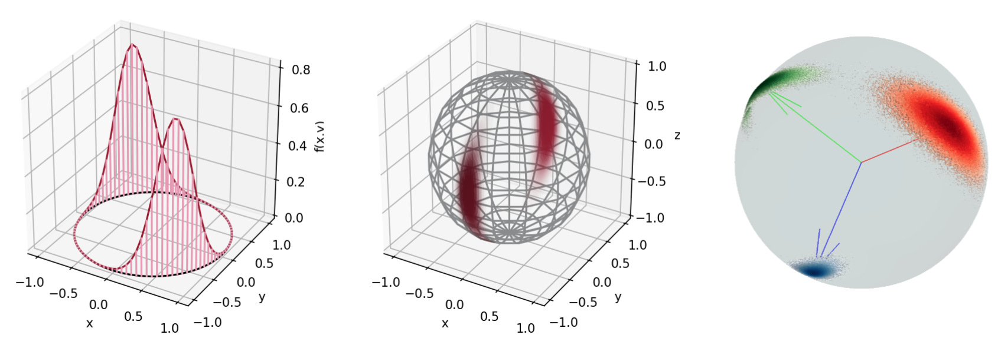
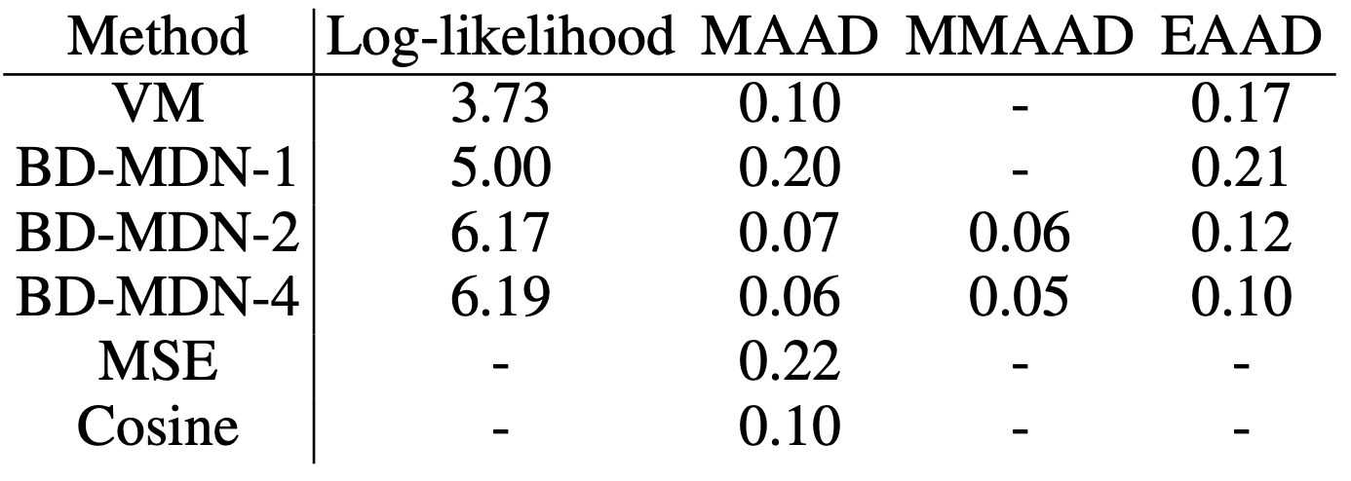
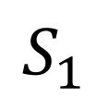
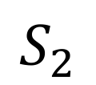
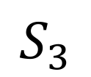
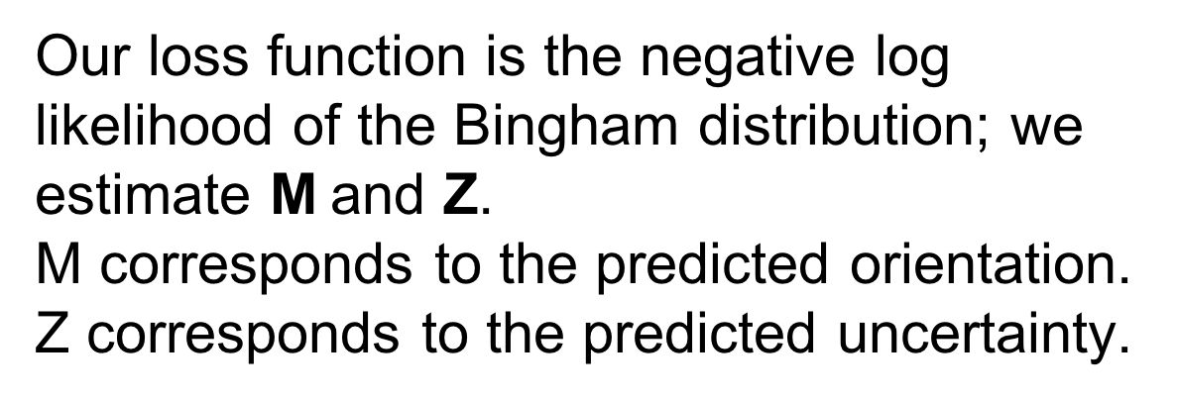
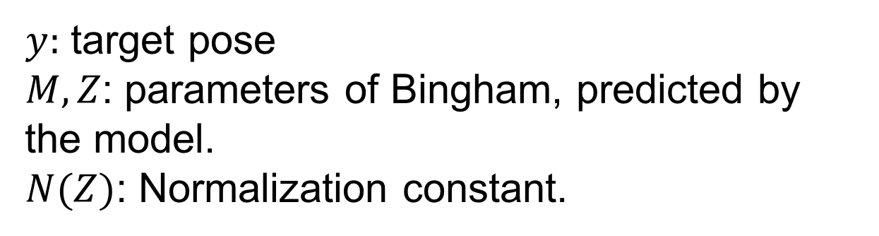
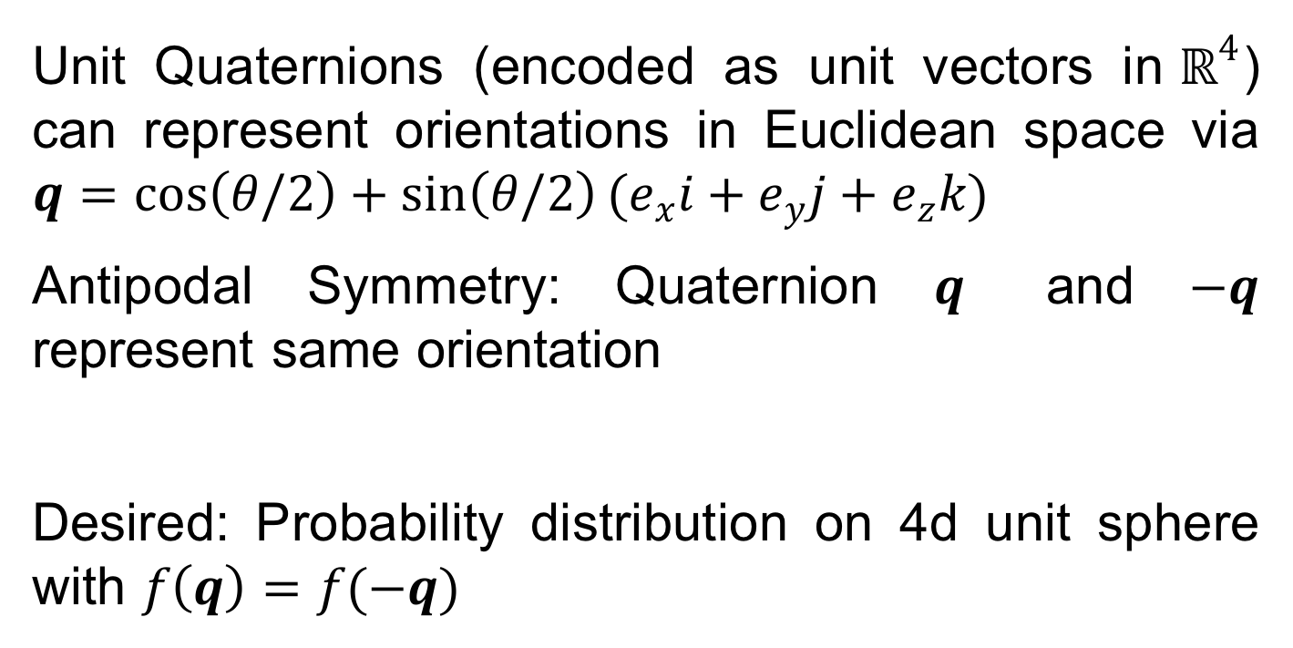
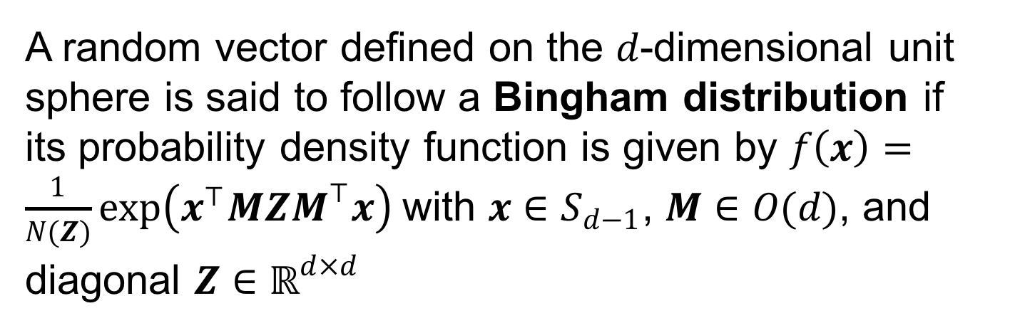
Deep Orientation Uncertainty Learning with a Bingham Loss
Igor Gilitschenski ¹, Roshni Sahoo ¹, Wilko Schwarting ¹, Alexander Amini ¹, Sertac Karaman ², Daniela Rus ¹
¹ MIT CSAIL, ² MIT LIDS
Overview
Orientation & Uncertainty Estimation!
Results
We propose a novel loss function for quaternion-based deep orientation estimation using the Bingham Distribution, which allows for representation of rotational symmetries.
Datasets
Head Pose
Unit Quaternions
UPNA (Ariz et al., 2016)
IDIAP (Odobez, 2003)
Textureless Objects
Unit Quaternions (encoded as unit vectors in$ℝ^{4}$) can represent orientations in Euclidean space via $q=\cos\left(θ/2\right)+\sin\left(θ/2\right)(e_{x}i+e_{y}j+e_{z}k)$
Antipodal Symmetry: Quaternion $q$ and $−q$ represent same orientation
Desired: Probability distribution on 4d unit sphere with $f\left(q\right)=f(−q)$
Bingham Loss Function
Metrics
Our loss function is the negative log likelihood of the Bingham distribution; we estimate M and Z.
M corresponds to the predicted orientation.
Z corresponds to the predicted uncertainty.
MAAD (mean absolute angular deviation) – the angular distance between the target and predicted angles.
EAAD (expected absolute angular deviation) –the expected angular deviation over a probability distribution parameterized by predicted value of Z.
We aim to minimize |EAAD – MAAD|.
T-Less (Hodan et al., 2017)
Calibrated Uncertainty Experiments
$y:$ target pose
$M, Z$: parameters of Bingham, predicted by the model.
$N(Z)$: Normalization constant.
Bingham Distribution
A random vector defined on the $d$-dimensional unit sphere is said to follow a Bingham distribution if its probability density function is given by $f\left(x\right)=\frac{1}{N(Z)}\exp\left(x^{⊤}MZM^{⊤}x\right)$with $x∈S_{d−1}$, $M∈O(d)$, and diagonal $Z∈ℝ^{d×d}$
Proposed Methodology
High Uncertainty Regime
Low Uncertainty Regime
$$S_{1}$$
$$S_{2}$$
$$S_{3}$$

